Slide 2

NetBeans IDE 8

Slide 3
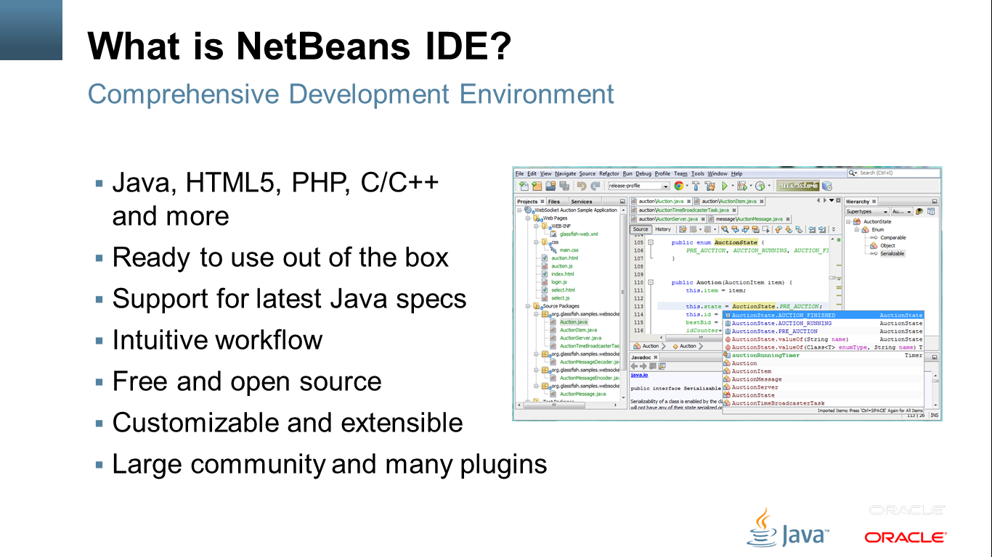
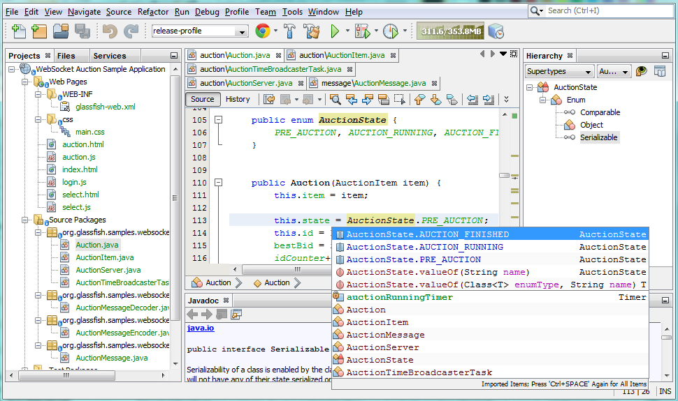
What is NetBeans IDE?
Comprehensive Development Environment
Java, HTML5, PHP, C/C++ and more
Ready to use out of the box
Support for latest Java specs
Intuitive workflow
Free and open source
Customizable and extensible
Large community and many plugins

Slide 4
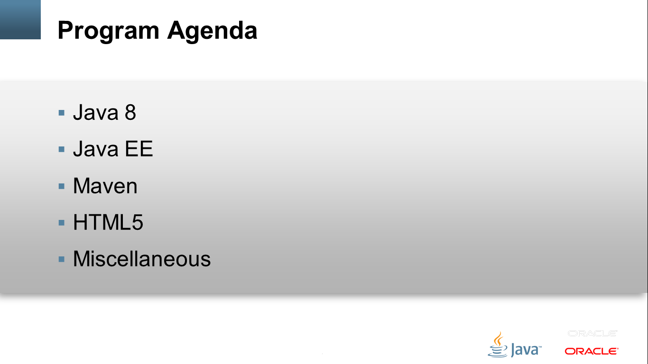
Program Agenda
Java 8
Java EE
Maven
HTML5
Miscellaneous

Slide 5
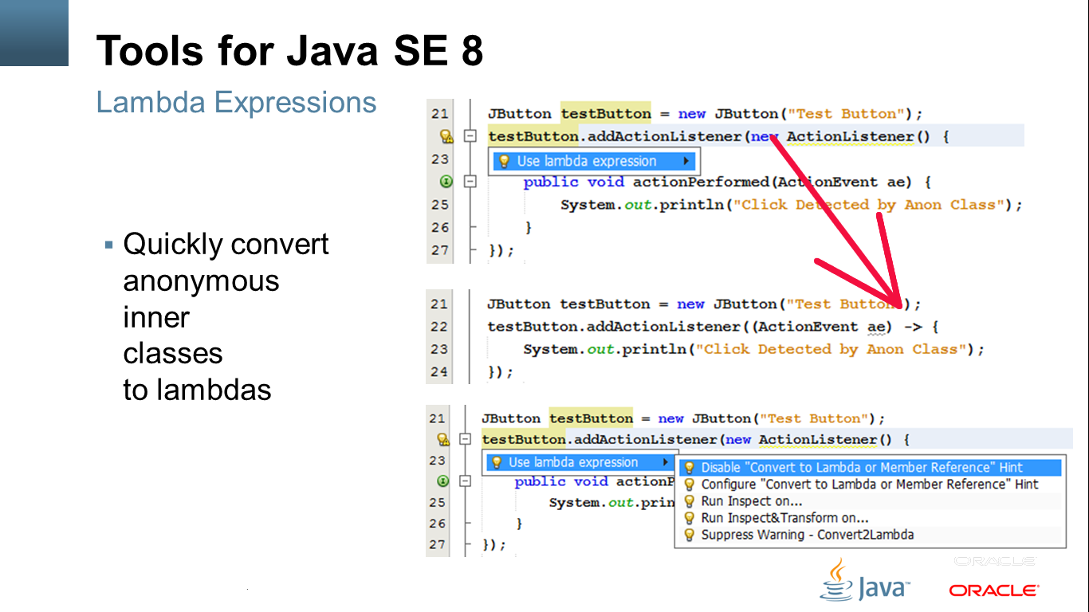
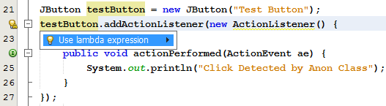
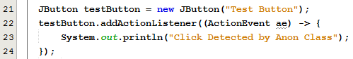
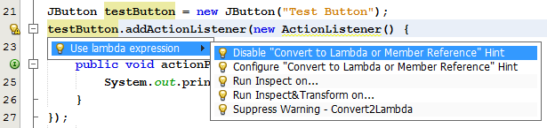
Tools for Java SE 8
Lambda Expressions
Quickly convert anonymous inner classes to lambdas

Slide 6
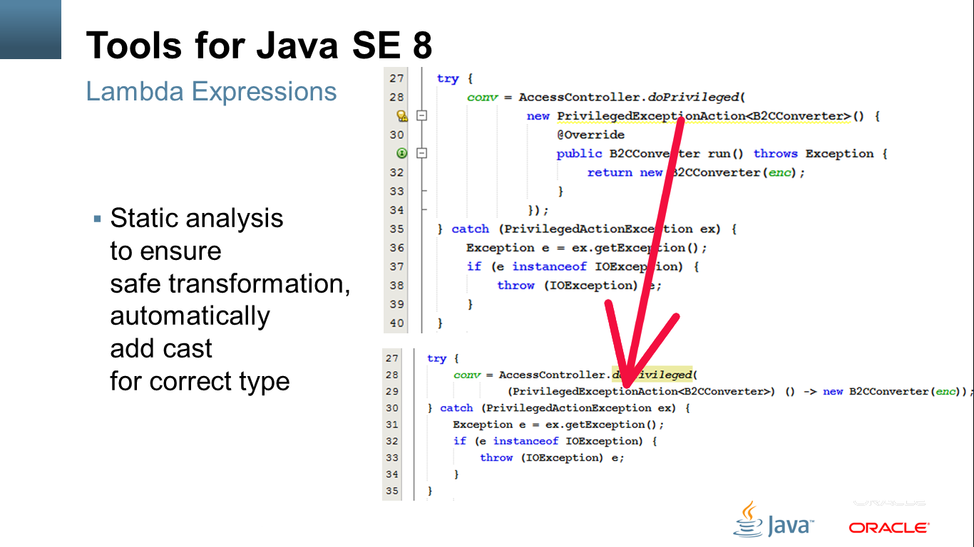
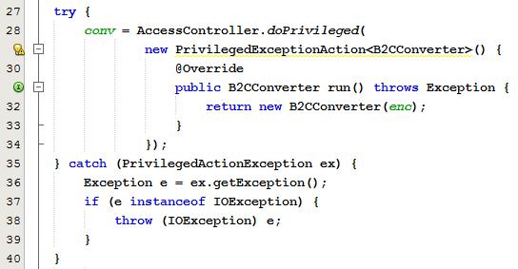
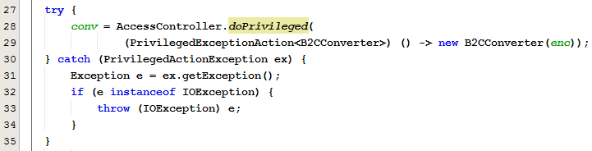
Tools for Java SE 8
Lambda Expressions
Static analysis to ensure safe transformation, automatically add cast for correct type

Slide 7
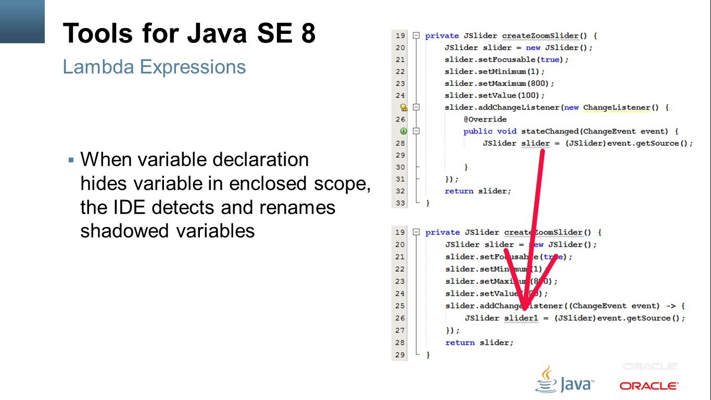
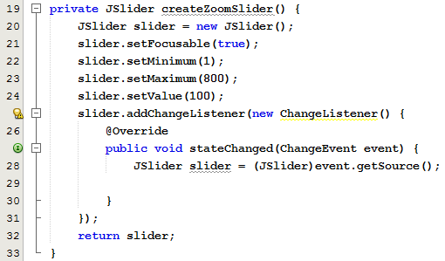
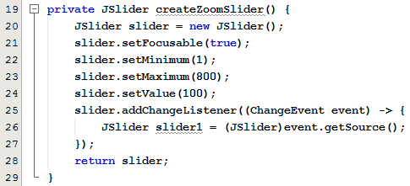
Tools for Java SE 8
Lambda Expressions
When variable declaration hides variable in enclosed scope, the IDE detects and renames shadowed variables

Slide 8
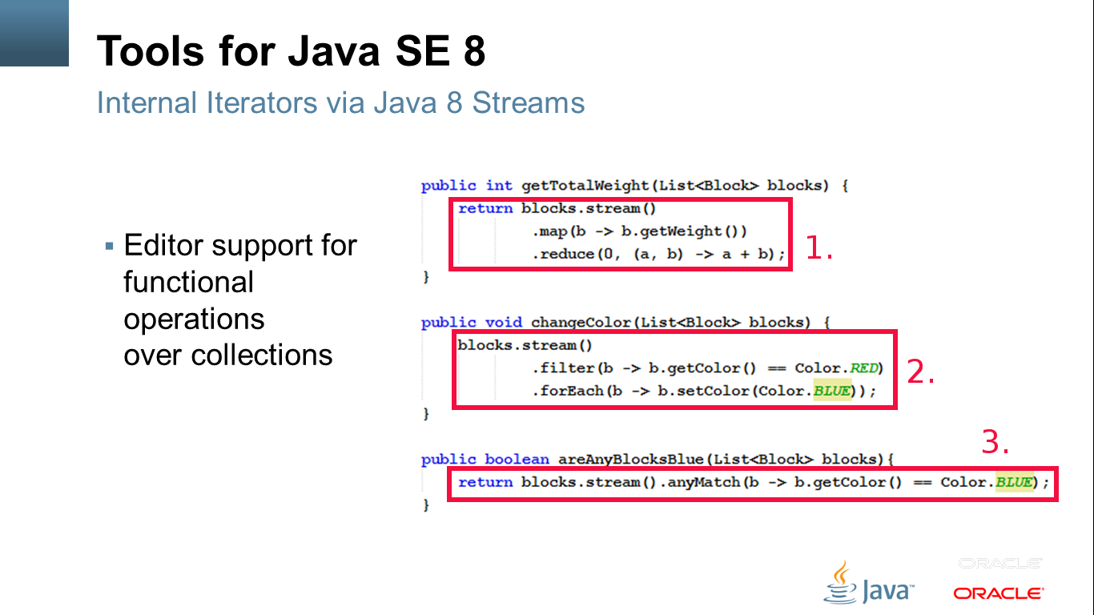
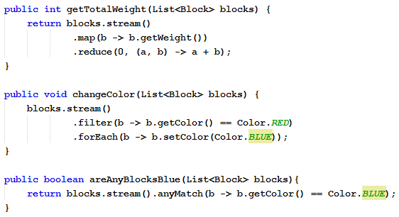
Tools for Java SE 8
Internal Iterators via Java 8 Streams
Editor support for functional operations over collections

Slide 9
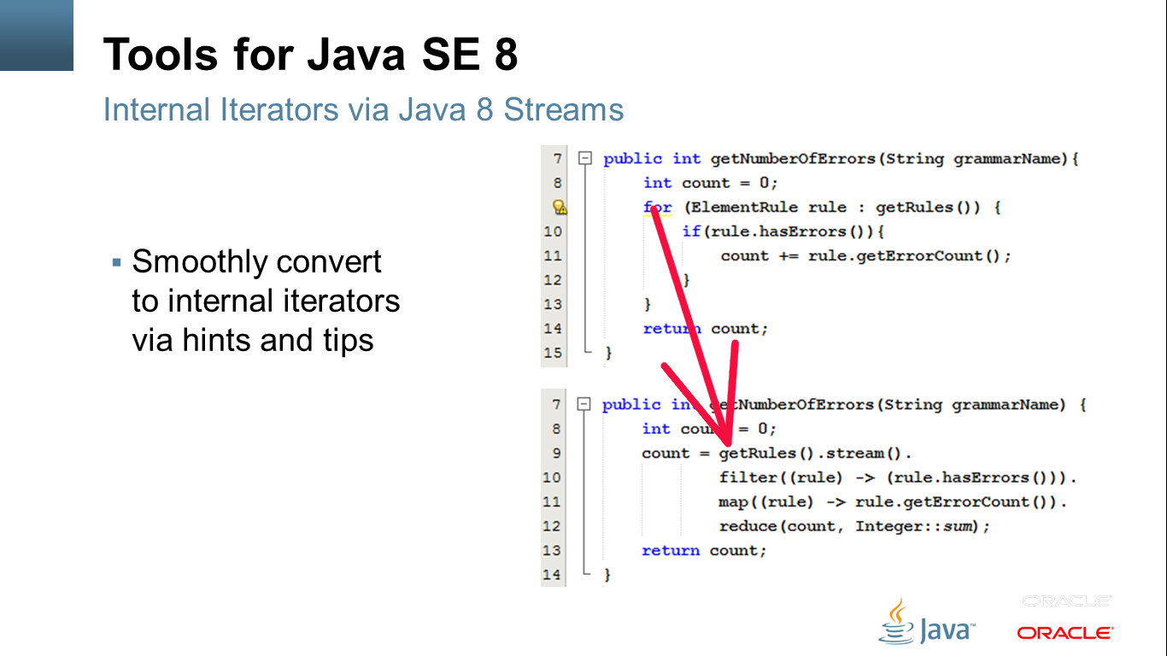
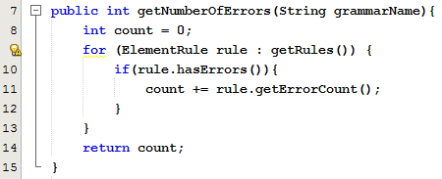
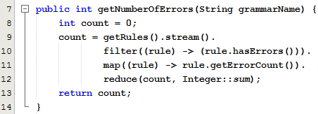
Tools for Java SE 8
Internal Iterators via Java 8 Streams
Smoothly convert to internal iterators via hints and tips

Slide 10
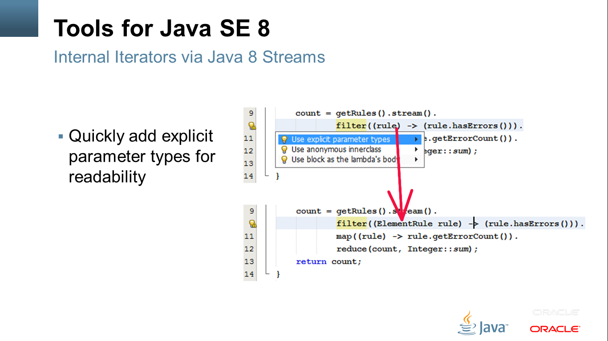
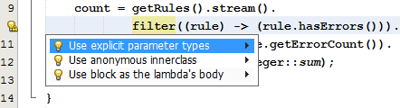
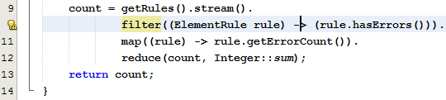
Tools for Java SE 8
Internal Iterators via Java 8 Streams
Quickly add explicit parameter types for readability

Slide 11
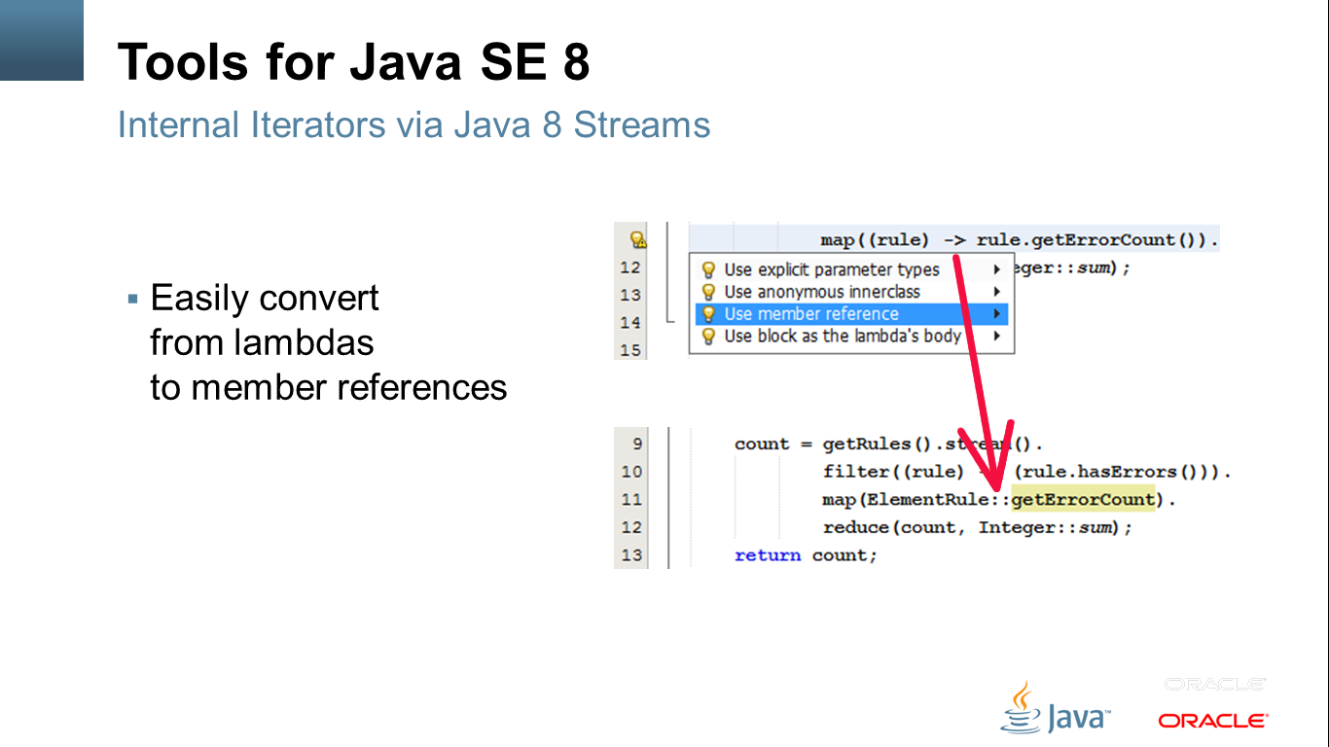
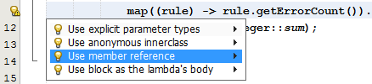
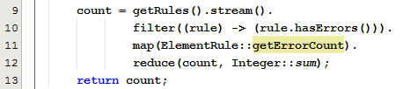
Tools for Java SE 8
Internal Iterators via Java 8 Streams
Easily convert from lambdas to member references

Slide 12
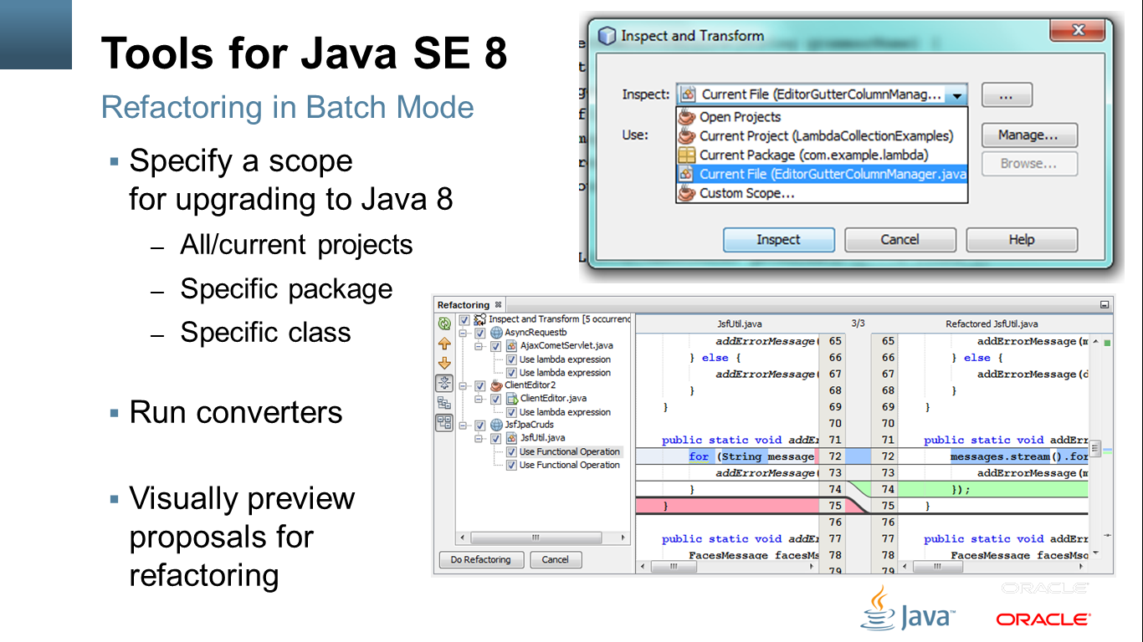
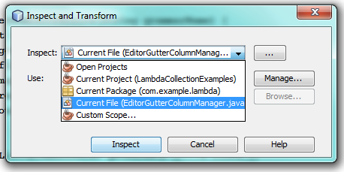
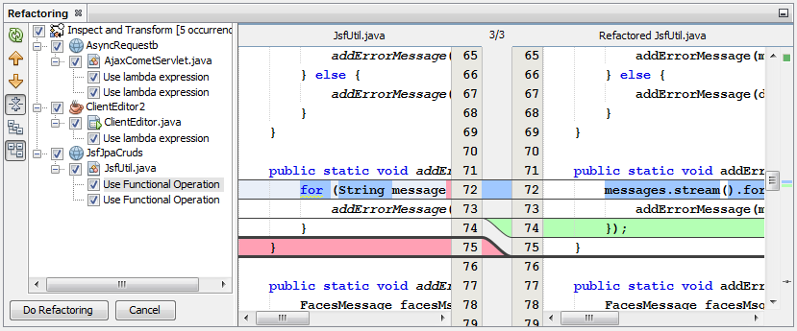
Tools for Java SE 8
Refactoring in Batch Mode
Specify a scope for upgrading to Java 8
All/current projects
Specific package
Specific class
Run converters
Visually preview proposals for refactoring

Slide 13
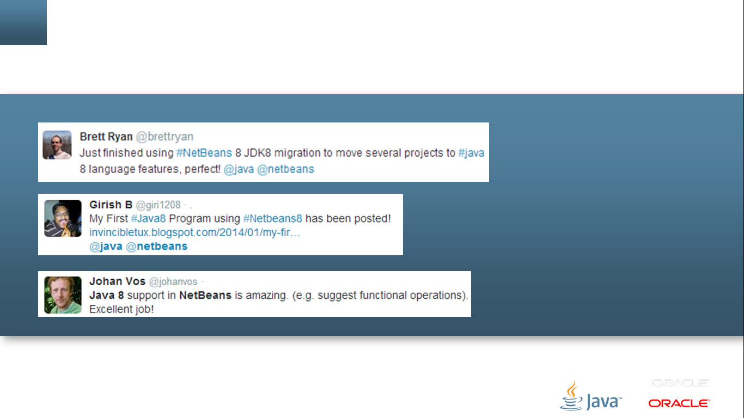




Slide 14
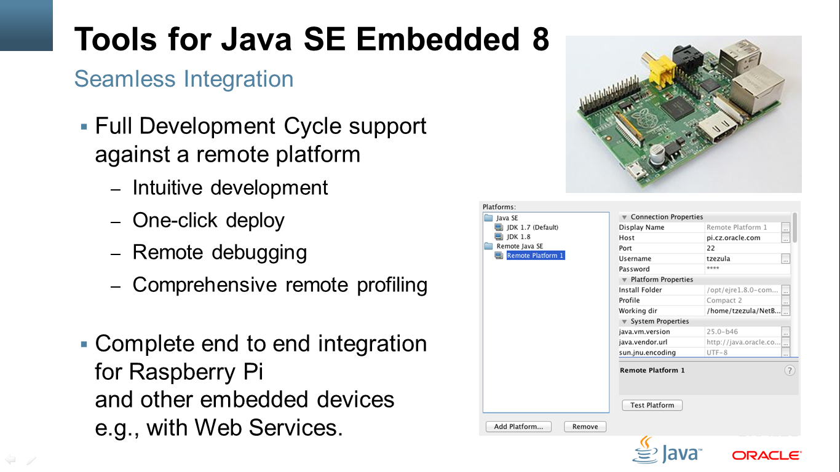
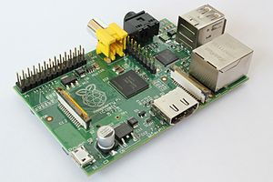
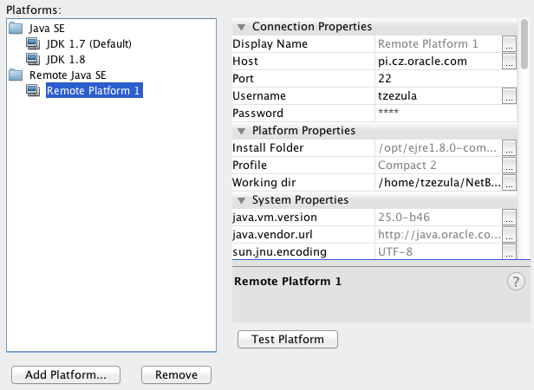
Tools for Java SE Embedded 8
Seamless Integration
Full Development Cycle support against a remote platform
Intuitive development
One-click deploy
Remote debugging
Comprehensive remote profiling
Complete end to end integration for Raspberry Pi and other embedded devices e.g., with Web Services.

Slide 15
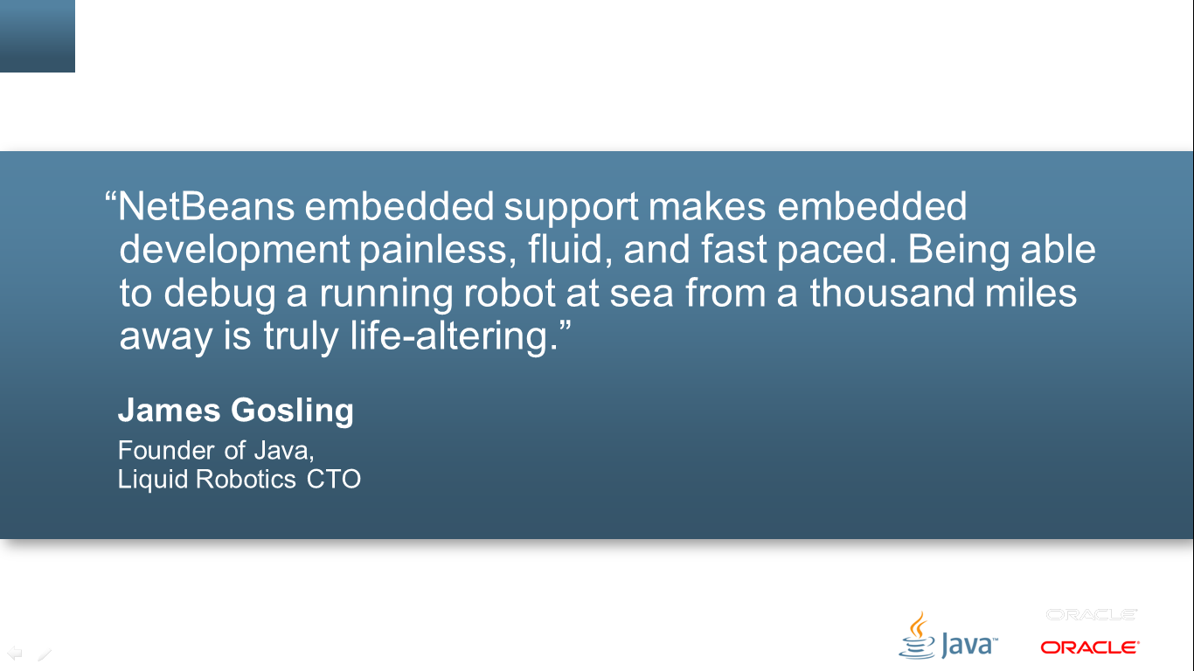
“NetBeans embedded support makes embedded development painless, fluid, and fast paced. Being able to debug a running robot at sea from a thousand miles away is truly life-altering.”
James Gosling
Founder of Java, Liquid Robotics CTO

Slide 16
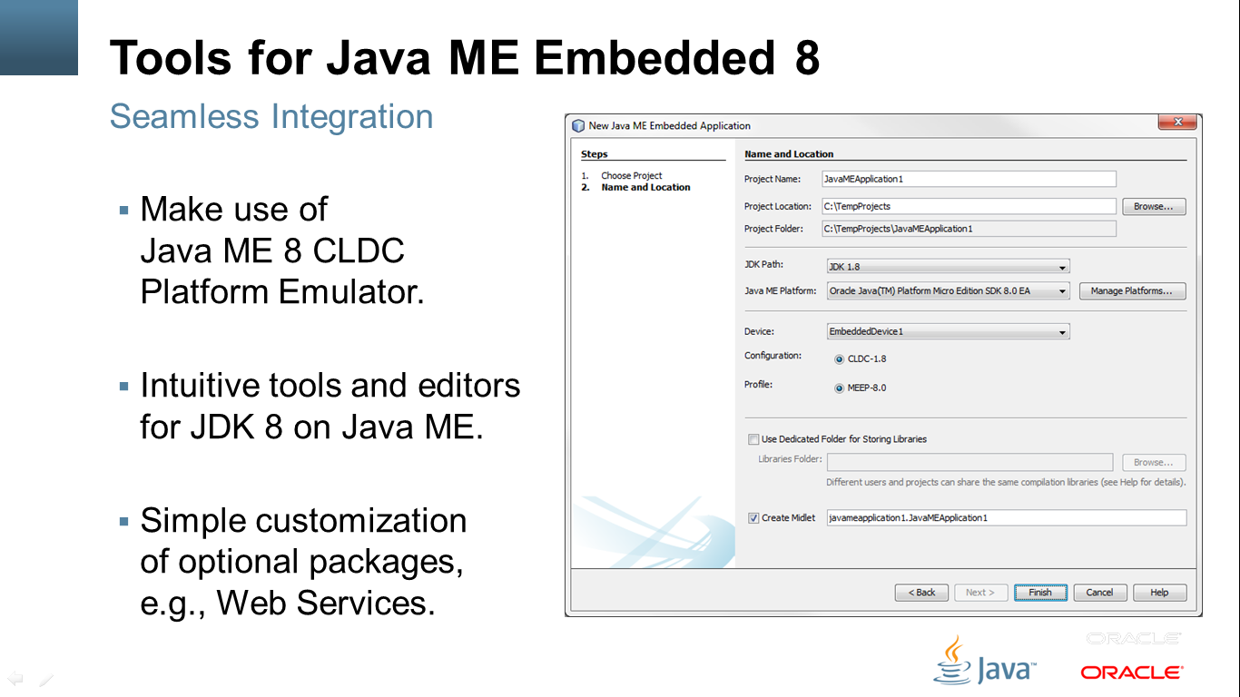
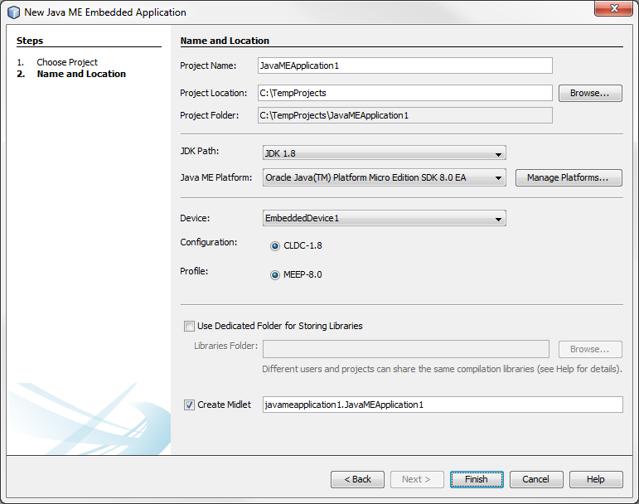
Tools for Java ME Embedded 8
Seamless Integration
Make use of Java ME 8 CLDC Platform Emulator.
Intuitive tools and editors for JDK 8 on Java ME.
Simple customization of optional packages, e.g., Web Services.

Slide 17
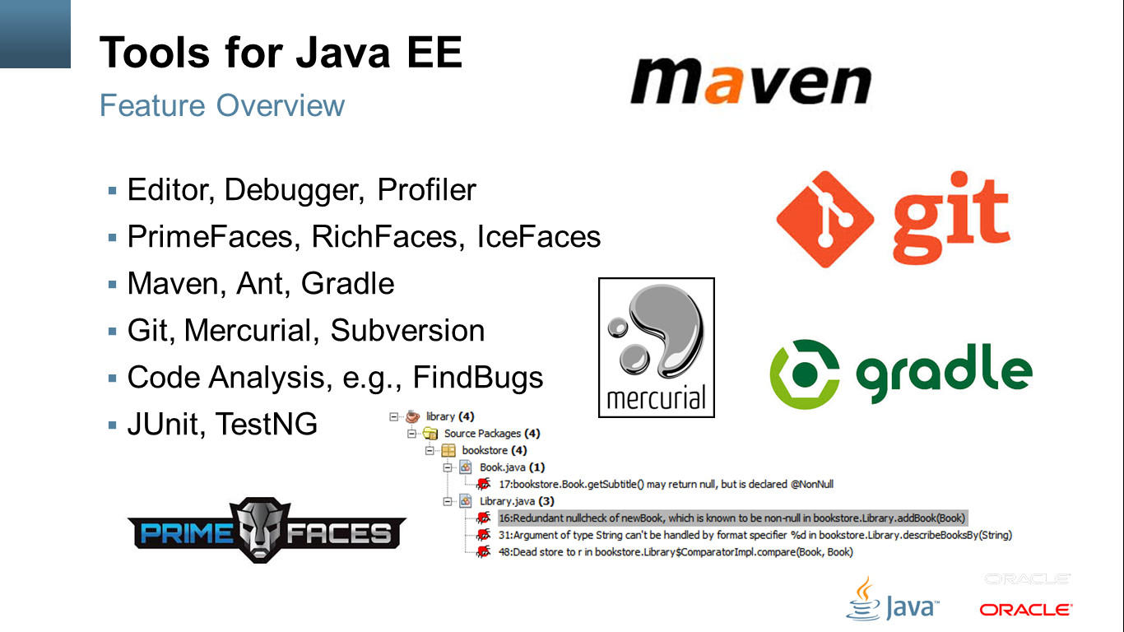




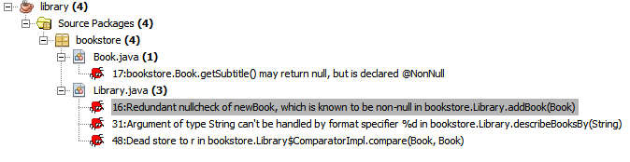

Tools for Java EE
Feature Overview
Editor, Debugger, Profiler
PrimeFaces, RichFaces, IceFaces
Maven, Ant, Gradle
Git, Mercurial, Subversion
Code Analysis, e.g., FindBugs
JUnit, TestNG

Slide 18
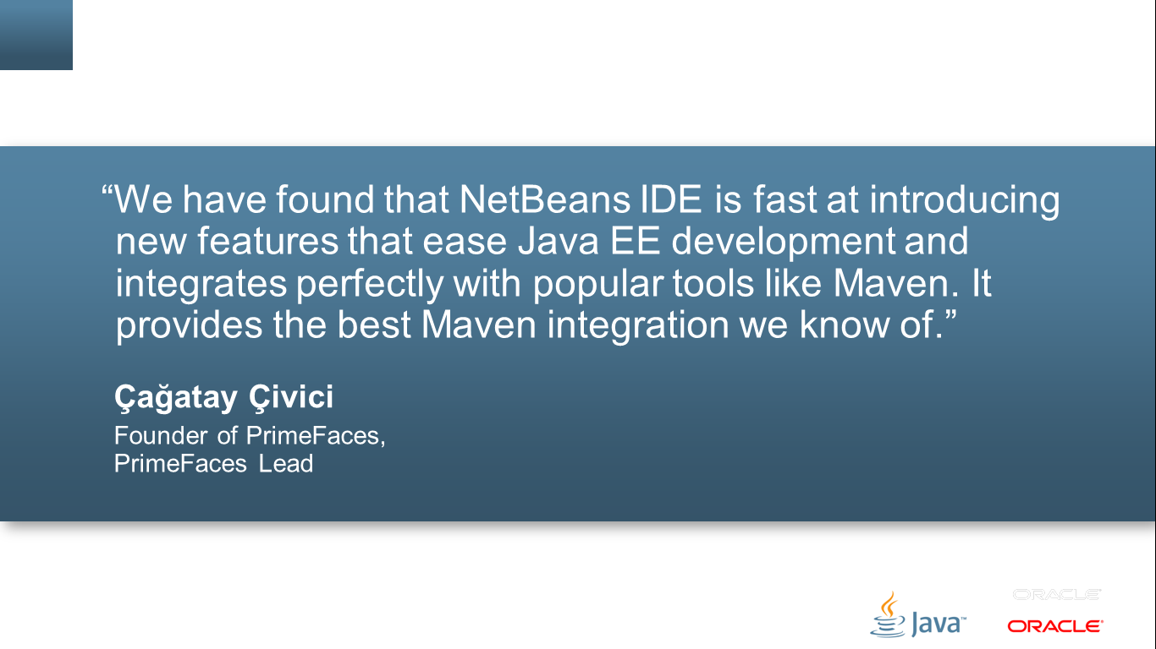
“We have found that NetBeans IDE is fast at introducing new features that ease Java EE development and integrates perfectly with popular tools like Maven. It provides the best Maven integration we know of.”
Çağatay Çivici
Founder of PrimeFaces, PrimeFaces Lead

Slide 19
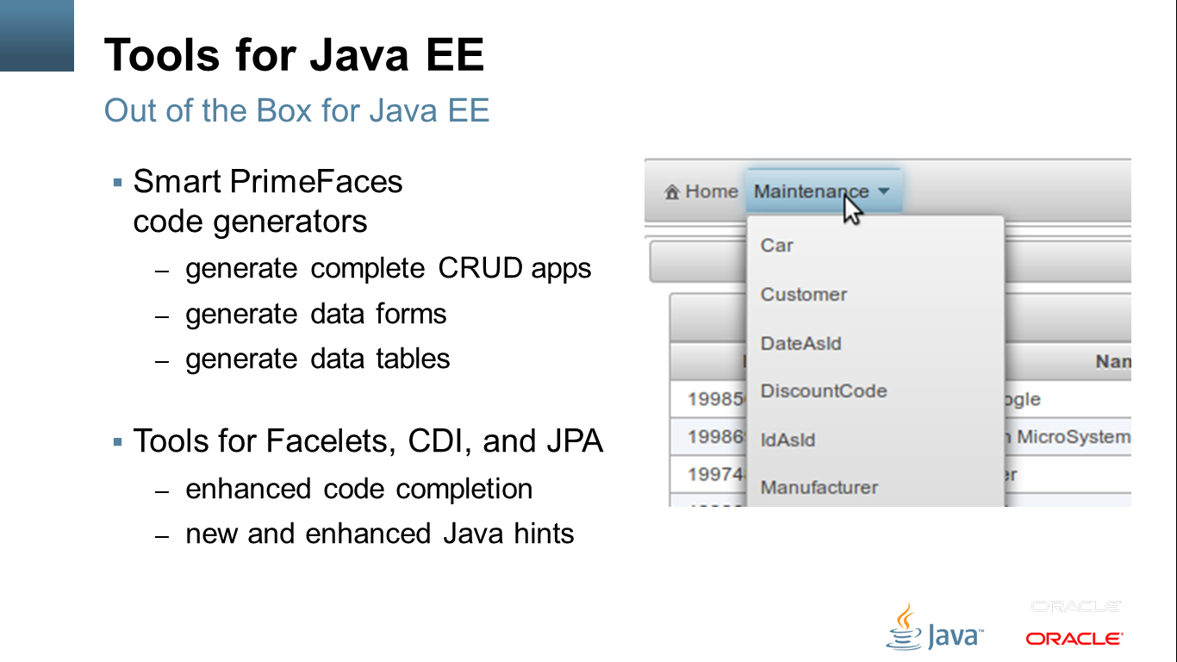
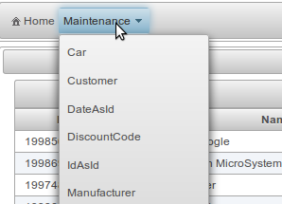
Tools for Java EE
Out of the Box for Java EE
Smart PrimeFaces code generators
generate complete CRUD apps
generate data forms
generate data tables
Tools for Facelets, CDI, and JPA
enhanced code completion
new and enhanced Java hints

Slide 20
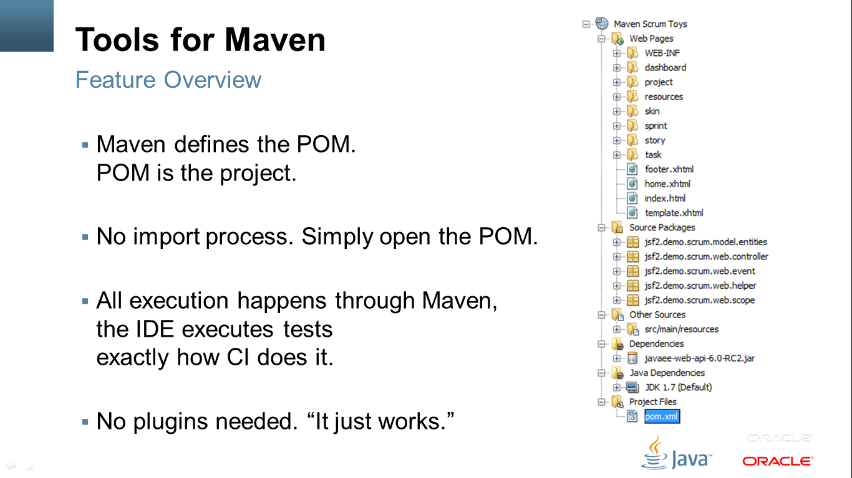
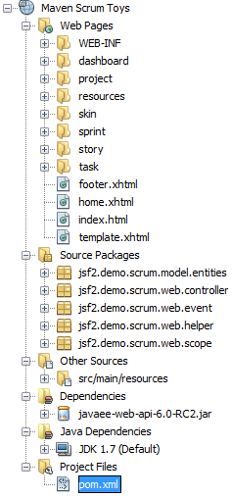
Tools for Maven
Feature Overview
Maven defines the POM. POM is the project.
No import process. Simply open the POM.
All execution happens through Maven, the IDE executes tests exactly how CI does it.
No plugins needed. “It just works.”

Slide 21
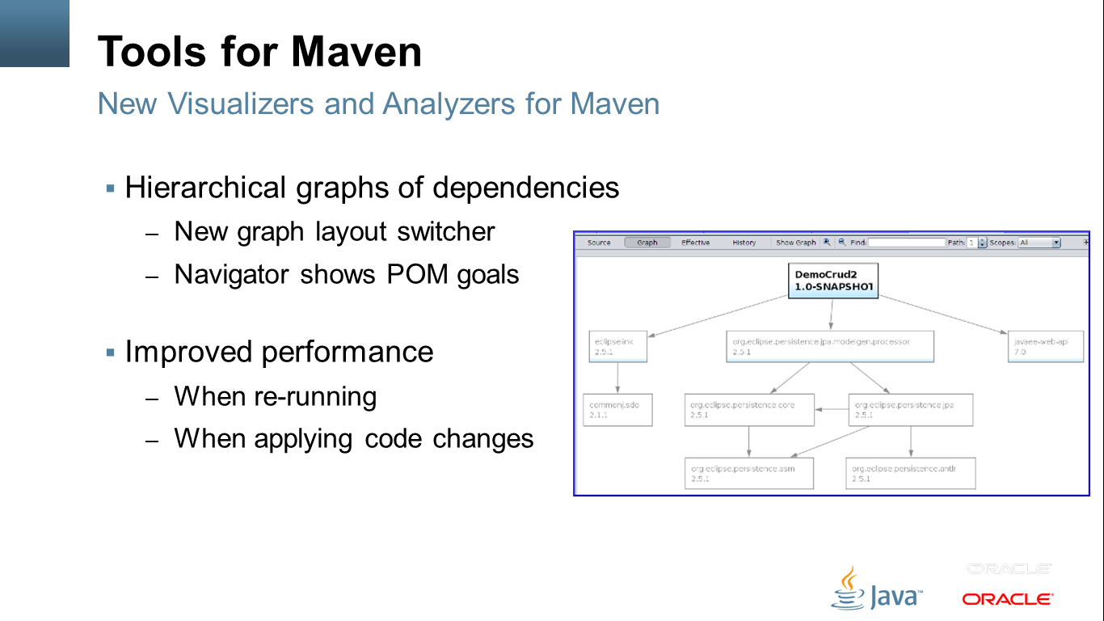
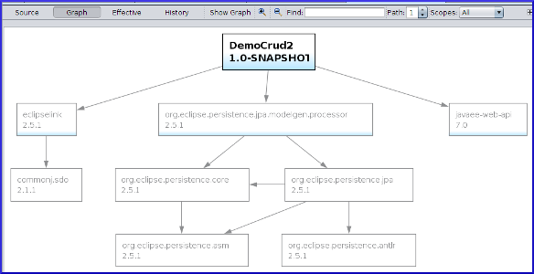
Tools for Maven
New Visualizers and Analyzers for Maven
Hierarchical graphs of dependencies
New graph layout switcher
Navigator shows POM goals
Improved performance
When re-running
When applying code changes

Slide 22
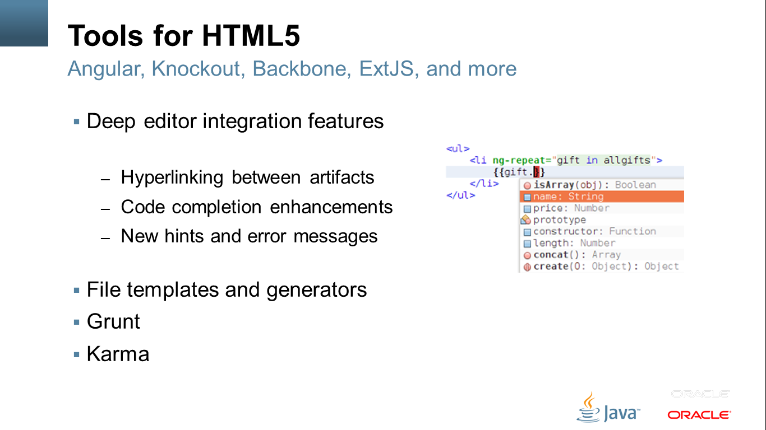
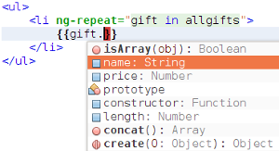
Tools for HTML5
Angular, Knockout, Backbone, ExtJS, jQuery, and more
Deep editor integration features
Hyperlinking between artifacts
Code completion enhancements
New hints and error messages
File templates and generators
Grunt
Karma

Slide 23
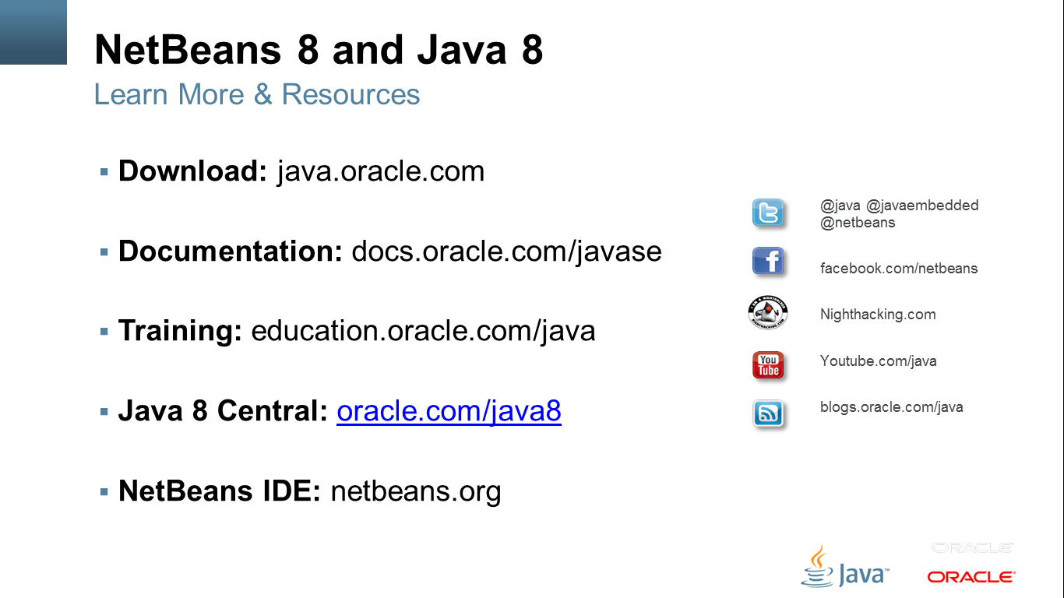





NetBeans 8 and Java 8
Learn More & Resources
Download: java.oracle.com
Documentation: docs.oracle.com/javase
Training: education.oracle.com/java
Java 8 Central: oracle.com/java8
NetBeans IDE: netbeans.org
@java @javaembedded @netbeans
facebook.com/netbeans
Nighthacking.com
Youtube.com/java
blogs.oracle.com/java

